Slide 1

Web Scraping Project National Park
Hsiang-Yuan(Joshua) Lee

Slide 2
Question
What is the good time to visit National Parks?
Which National Parks Campground is popular?

Slide 3
Website
https://en.wikipedia.org/wiki/
https://www.recreation.gov/
https://www.tripadvisor.com/
https://irma.nps.gov

Slide 4
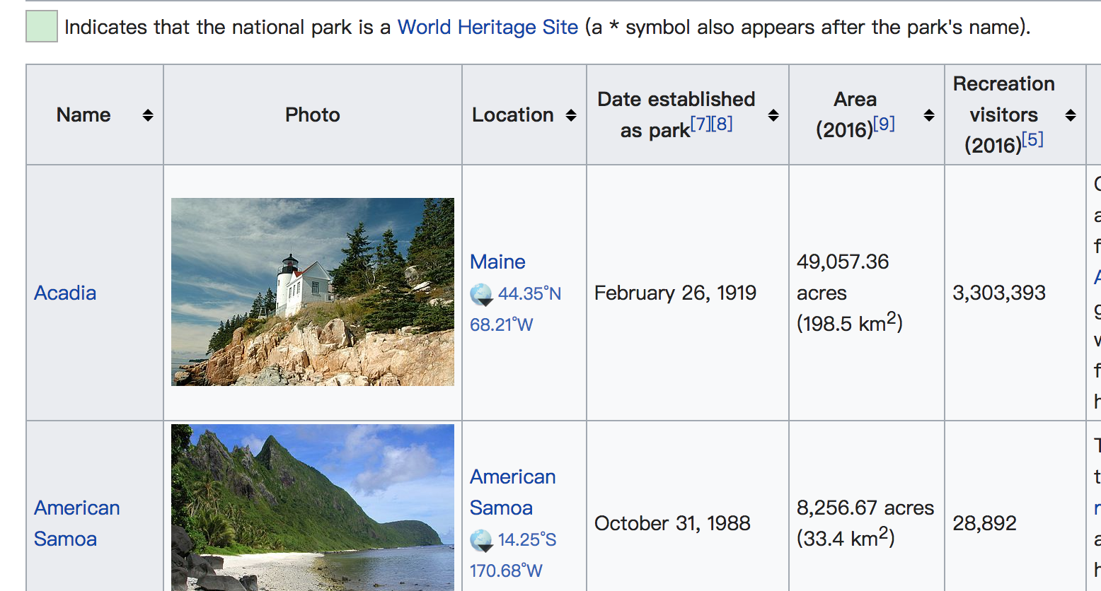
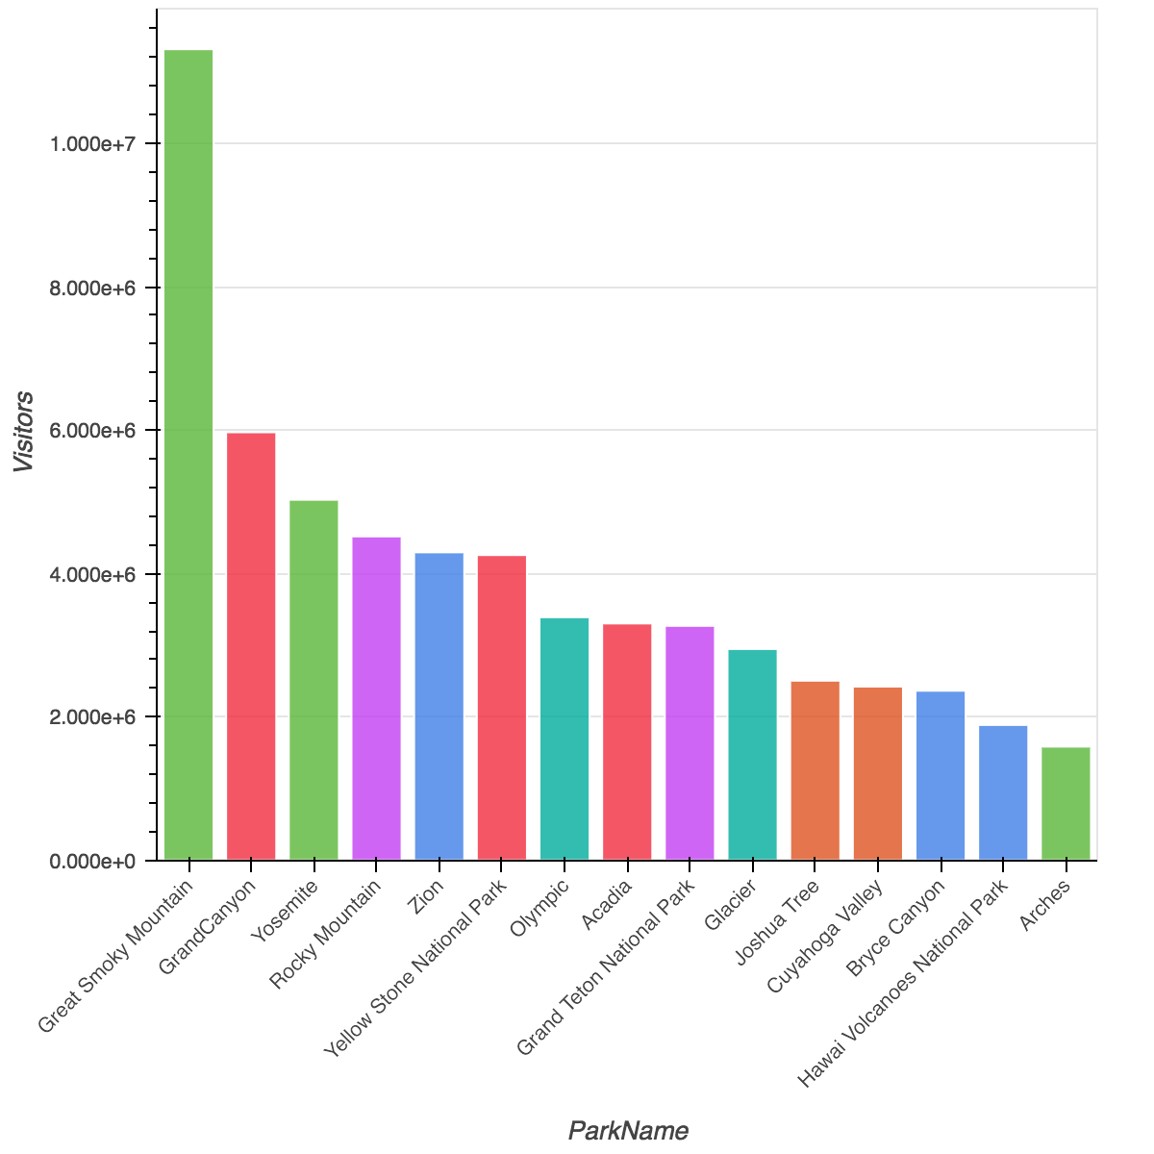
Visitors in each National Parks
Obviously, The Great Smoky Mountain has the highest Visitors

Slide 5
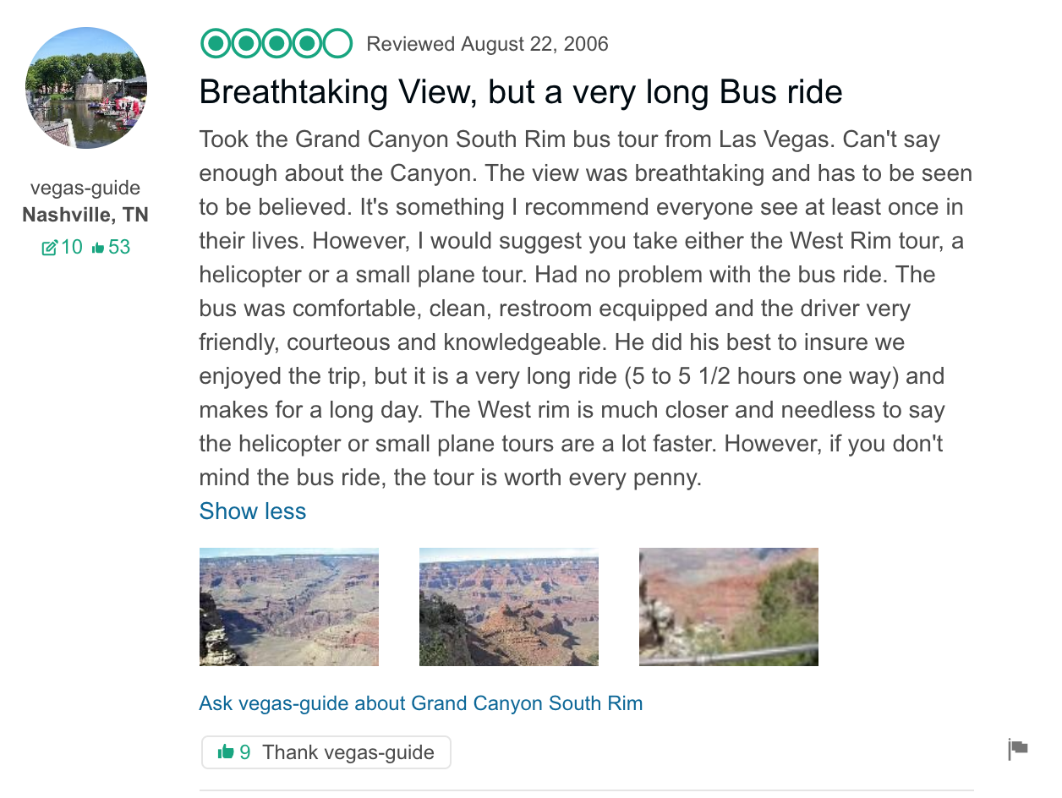
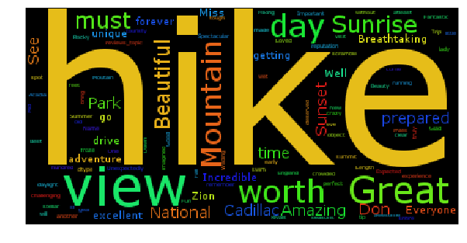
Word Cloud
Hiking!!!!!!

Slide 6
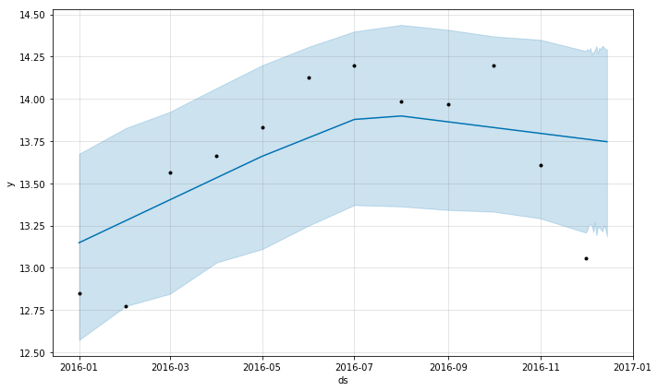
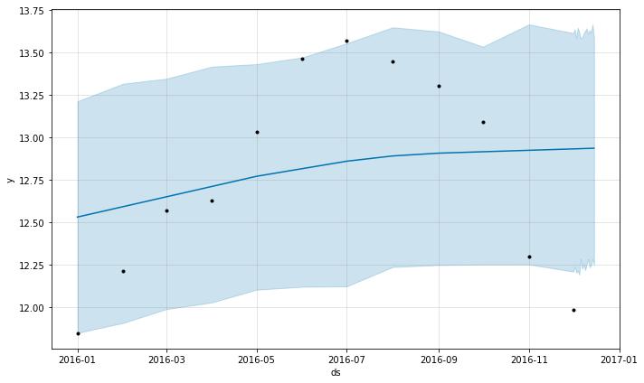
Time Series
Yosemite National Park
Great Smoky Mountain National Park

Slide 7
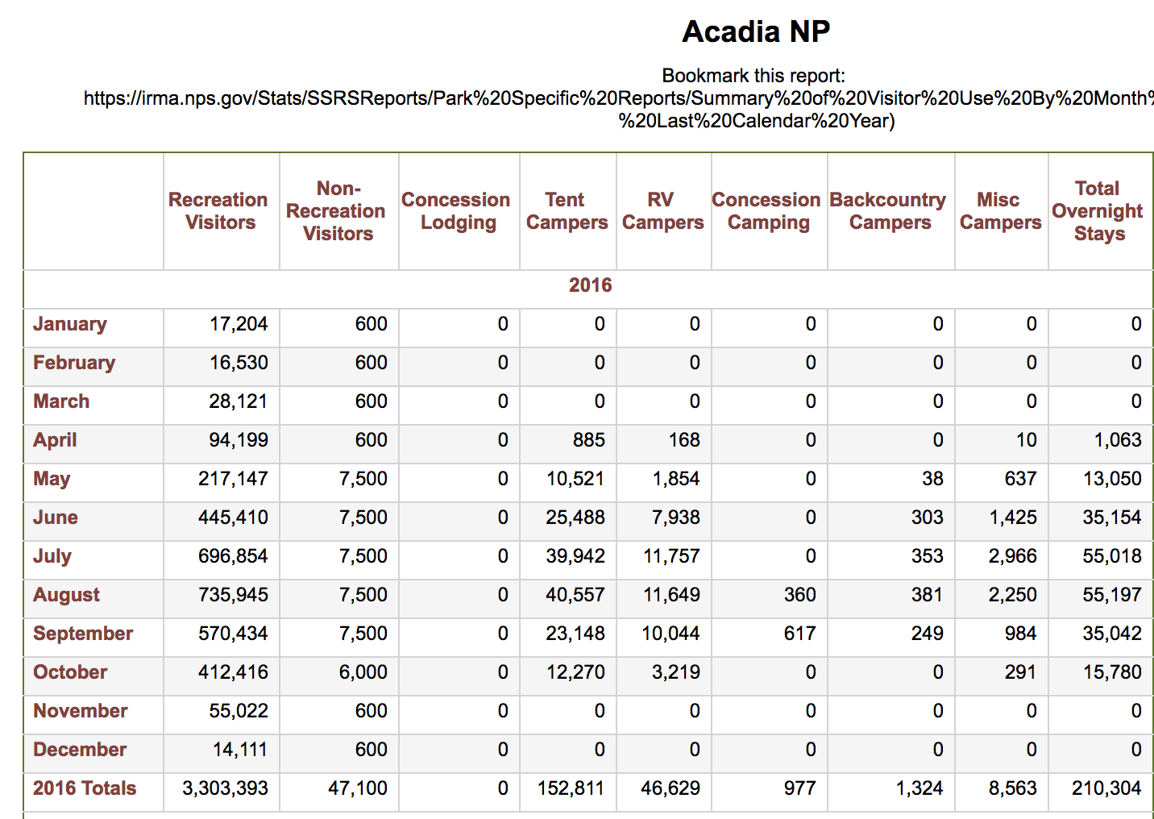
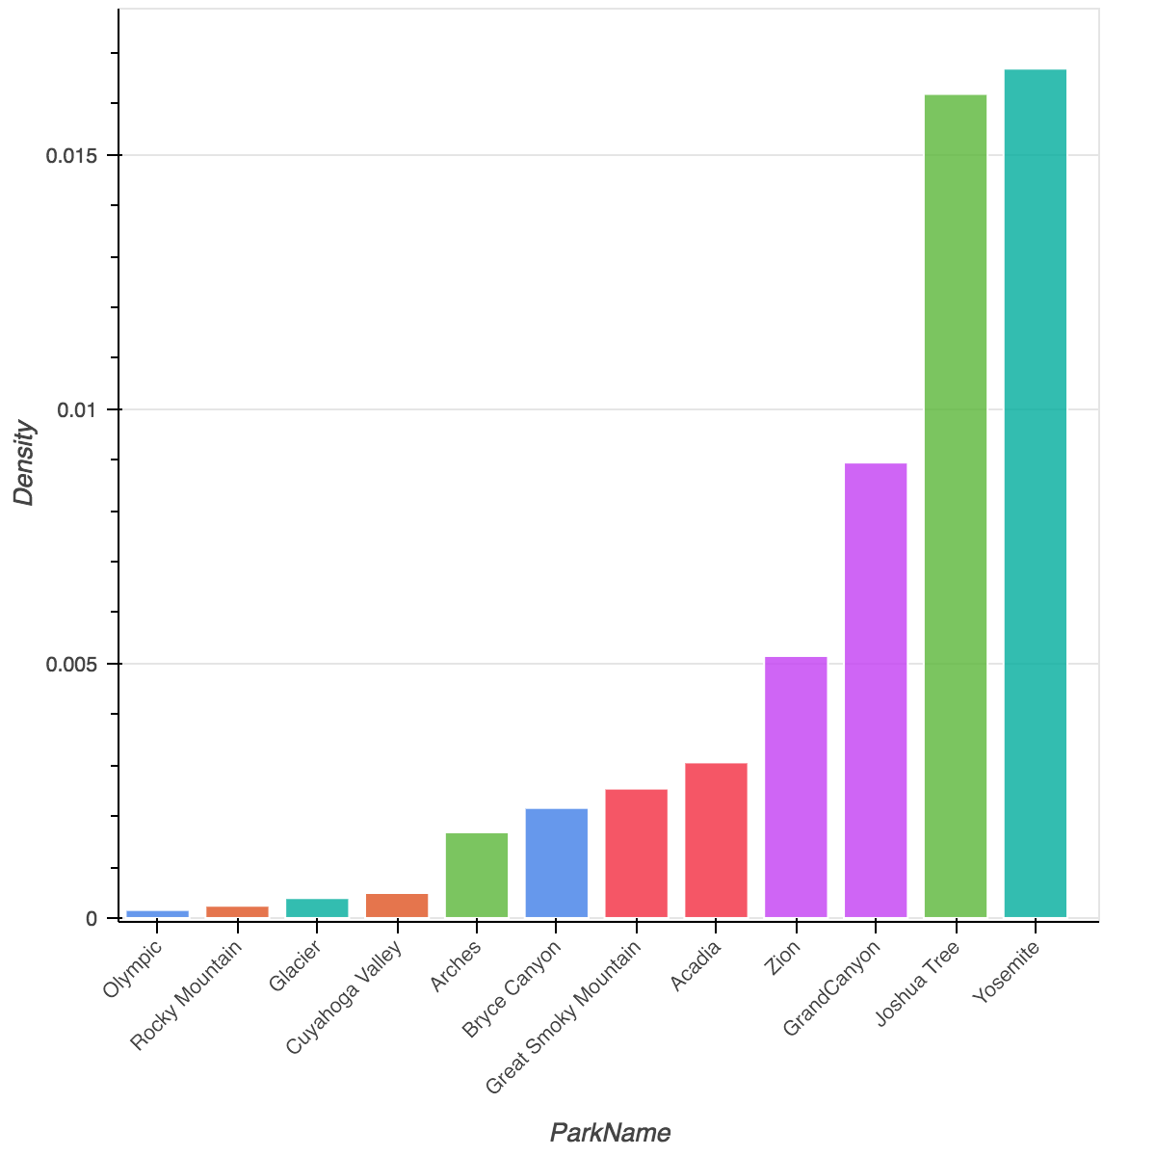
Density of the camping people

Slide 8
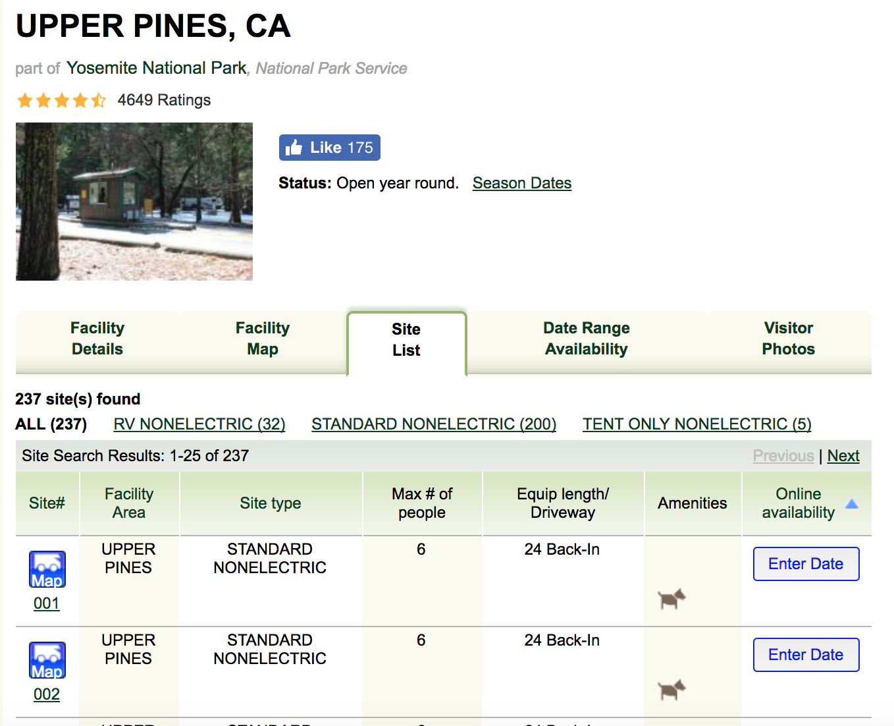
Accommodation for campers

Slide 9
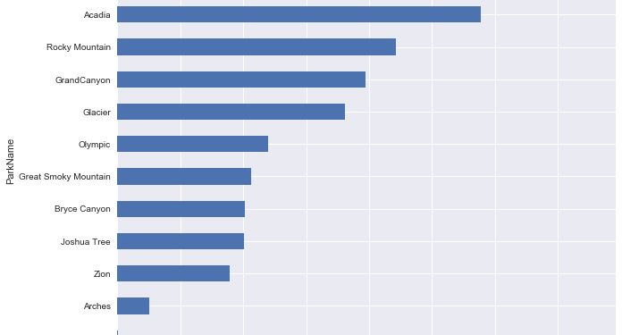
Accommodation for campers

Slide 10
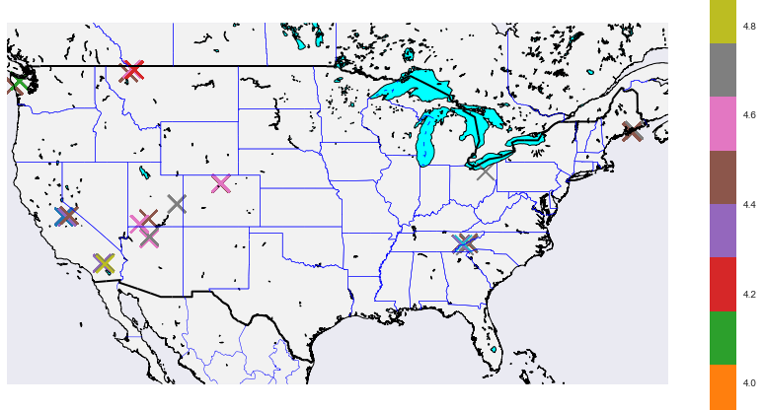
Map
Map based on stars

Slide 11
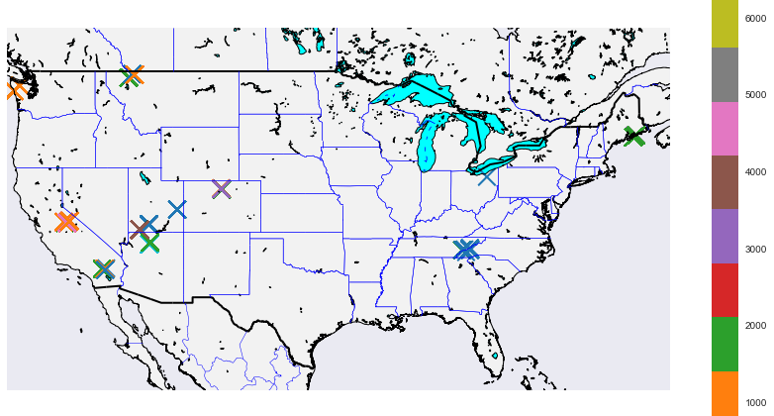
Map
Map based on reviews

